Slide 1



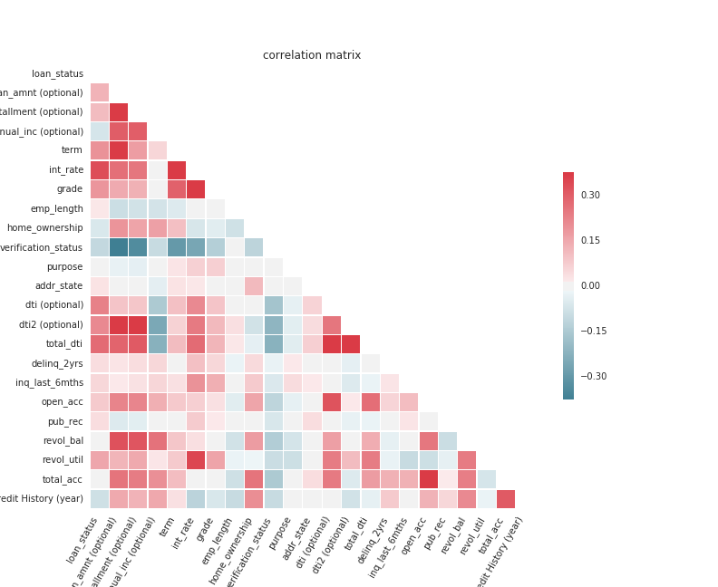
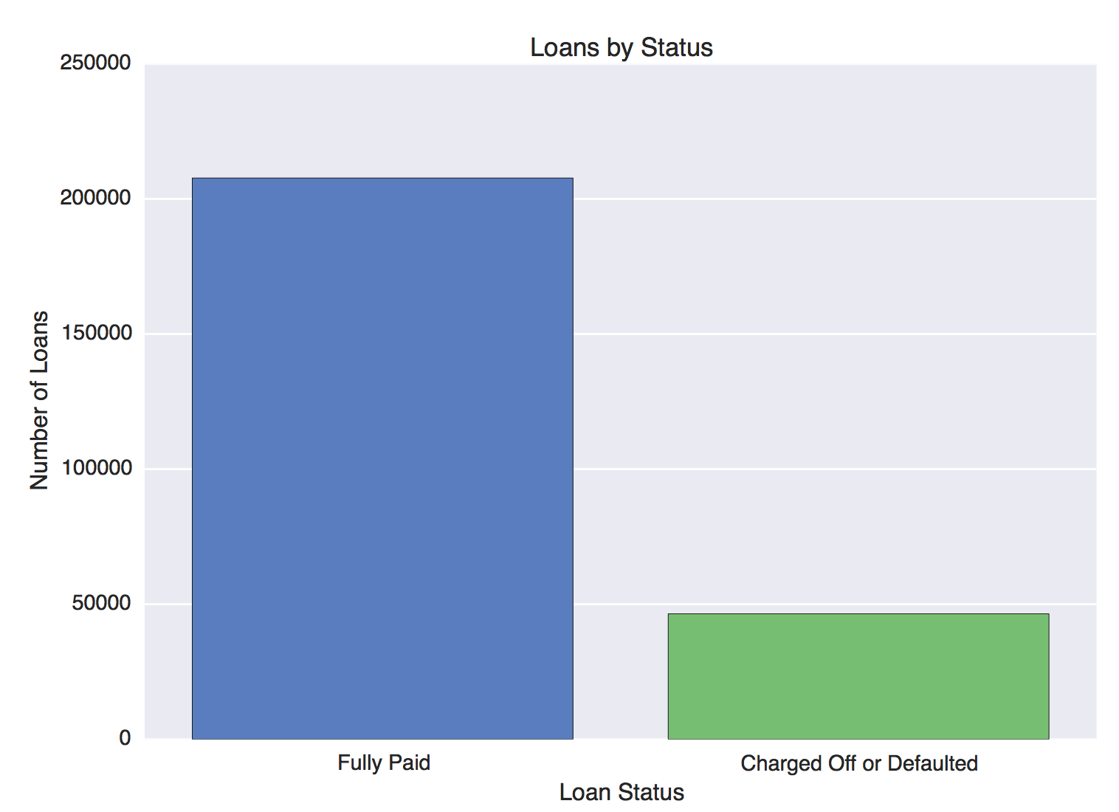
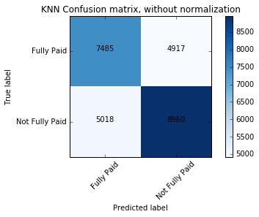
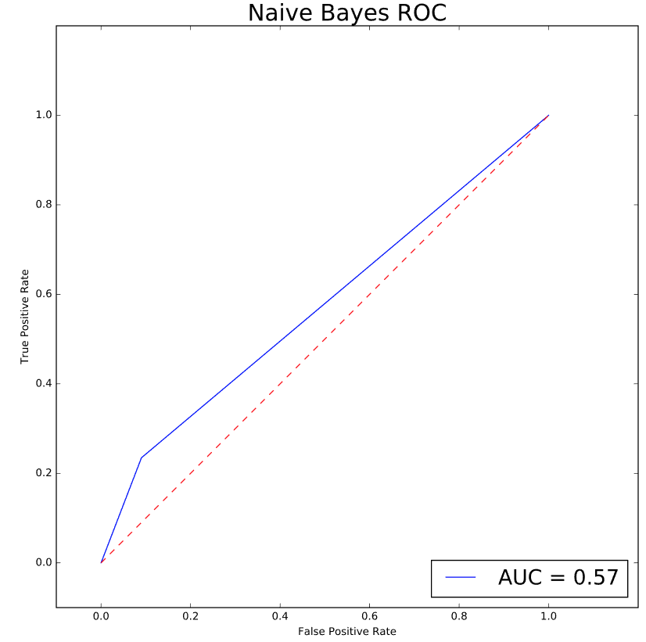
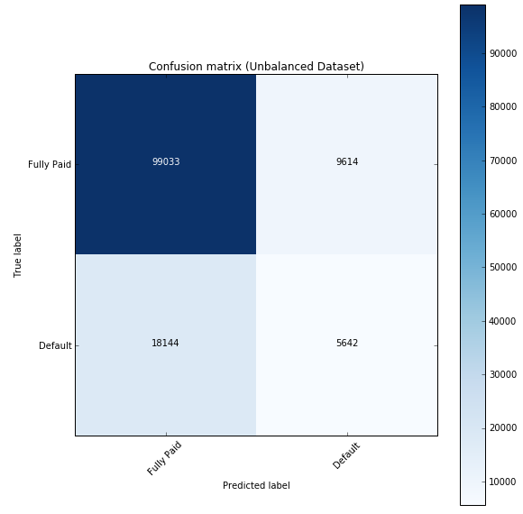
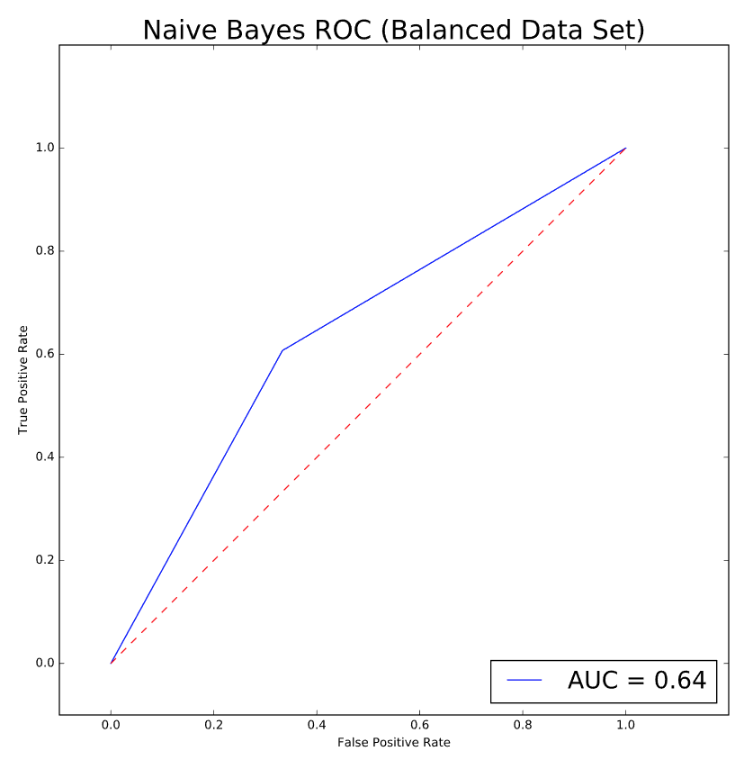
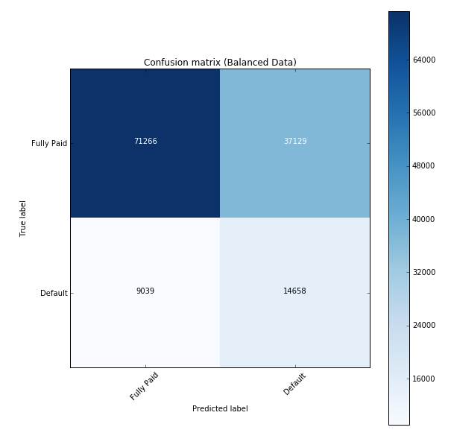
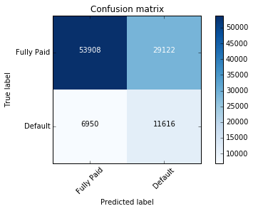
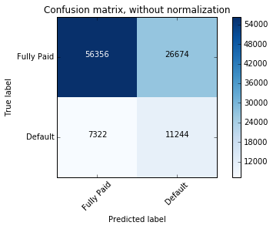
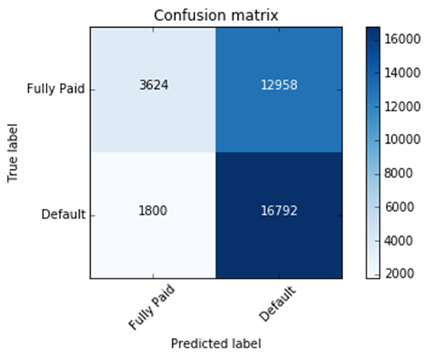
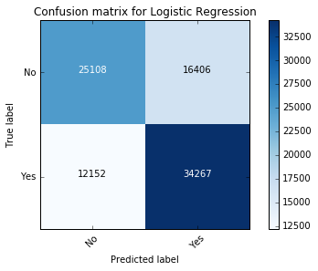


Predicting Outcomes of P2P Loans
←Word Cloud of loan titles
Loan Data
Word Cloud of loan descriptions→
Data
887,380 Total Loans
BACKGROUND: Lending Club is a peer-to-peer lending company that is headquartered in San Francisco, California. The company claims that $15.98 billion in loans had been originated through its platform up to 31 December 2015.
THE CHALLENGE: We assumed the role of an investor choosing Lending Club loans to fund. As such, we hope to be able to predict which loans carry the highest risk of default. Our effort was designed to use classifier algorithms to try and predict those customers who will default (1) versus those that will repay their loans in full (0).
DATA SCIENTISTS: This project was completed by the following MSA 8010 students in the Fall of 2016: Steve Bergey, Ben Brandon, Brian Christjohn, Rao Fu, Steve Spangler, and Zhongying Xiao.
Including current loans in progress
Correlation Matrix
Model Results
254,189
Completed Loans
KNN |  | Loan Status Class | Precision | Recall | F1
 | With Under Sampling | Default | .645 | .640 | .643
 | With Over Sampling | Default | .698 | .987 | .818
 | Original Results | Default | .24 | .08 | .12
Naïve Bayes |  | Loan Status Class | Precision | Recall | F1
 | Balanced Classes (Undersampling) | Default | .29 | .61 | .39
 |  | Fully Paid | .89 | .67 | .76
 |  | Avg/Total | .78 | .66 | .69
 | Before Balancing | Default | .37 | .27 | .31
 |  | Fully Paid | .85 | .90 | .87
 |  | Avg/Total | .76 | .79 | .77
Loan Attributes
Relative Symmetric Uncertainty
Decision Tree |  | Loan Status Class | Precision | Recall | F1
 | Balanced Classes | Default | .28 | .63 | .39
 |  | Fully Paid | .88 | .65 | .75
 |  | Avg/Total | .78 | .64 | .68
 | Before Balancing | Default | .46 | .02 | .05
 |  | Fully Paid | .82 | .99 | .90
 |  | Avg/Total | .75 | .82 | .74
Loan Term (36/60mths)
Loan Amount
Monthly Installment
LC Loan Grade
Interest Rate
Debt-to-Income Ratio
Annual Income
Revolving Credit Utilization
Loan Purpose
Credit Inquiries Last 6 Months
Rent/Own Home
Revolving Credit Balance
Credit History Length
Total Debt Accounts
Open Debt Accounts
Employment Length
Delinquencies last 2 years
Derogatory Records
Employment Verification
State / Zip Code
Red Numbers above indicate erroneous results due to the oversampling technique used
Four feature selection methods were used –
Selection by Information Gain
Variance Threshold Method
Principal Components Analysis
Feature Permutation - Itertools.Combination
Number of Loans & Average Loan Amount Per State
Best results achieved from using a maximum tree depth of 8 and only the top 4 features as ranked by information gain (Grade, Term, Interest Rate, Debt-to-Income Ratio). Balanced classes are result of ‘class_weight’ argument in scikit-learn’s classifier function, which uses the values of y to automatically adjust weights inversely proportional to class frequencies in the input data
SVM | Loan Status Class | Precision | Recall | F1
 | Default | .56 | .90 | .69
 | Fully Paid | .67 | .22 | .33
 | Avg/Total | .61 | .58 | .52
Logistic Regression | Loan Status Class | Precision | Recall | F1
 | Default | .69 | .70 | .69
 | Fully Paid | .66 | .64 | .65
 | Avg/Total | .67 | .67 | .67
Distribution of Continuous Features
Best results achieved from using 150 trees with a maximum depth of 10 and a maximum of 12 features, along with balanced class weighting
Library: Scikit-learn SVM, LinearSVC classifier Features Used: inq_last_6mths,total_dti Dataset Used: Undersampledata.csv Train/Test: 60/40 Ratio of correctly classified samples for: Training-set: 0.583692 Test-set: 0.580429
Random Forest | Loan Status Class | Precision | Recall | F1
 | Default | .30 | .61 | .40
 | Fully Paid | .89 | .68 | .77
 | Avg/Total | .78 | .67 | .70
The train/test ratio is 60/40. The eight key features were selected with the Recursive Feature Elimination Algorithm. Fewer features could improve the accuracy and recall of the model.
https://www.kaggle.com/wendykan/lending-club-loan-data

